Slide 1
CREATING A WEB SERVER USING NODE JS
Presented by:
BATCH -15
211FA04600
211FA05607
211FA04622
211FA04633
Presented to:
Mr.Kiran kumar

Slide 2
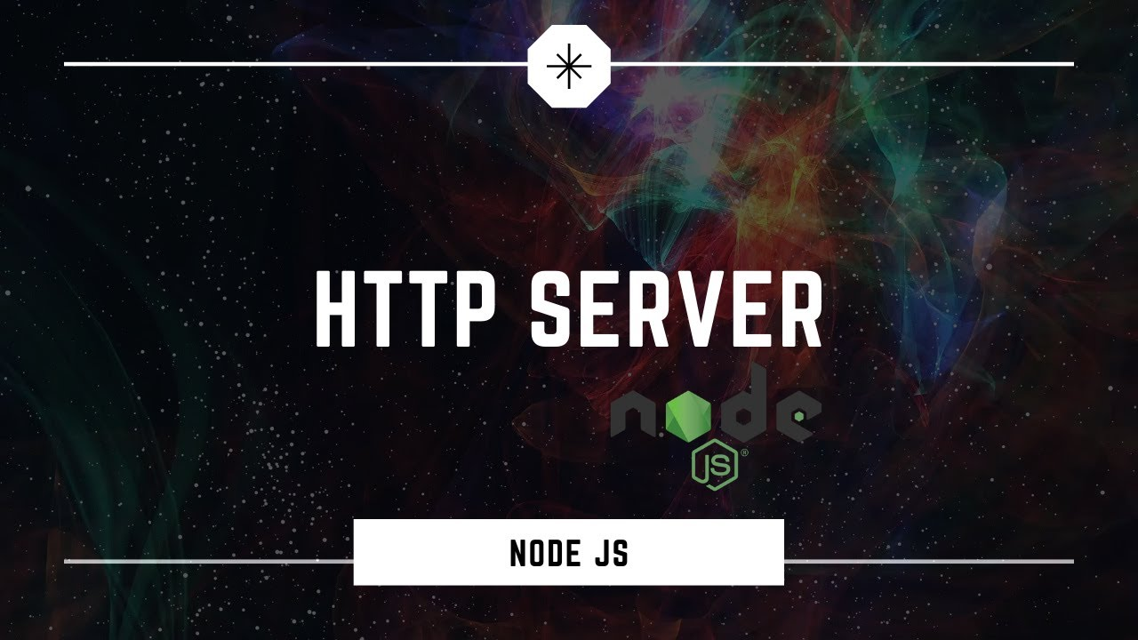
Contents
Node JS
What is web server
Working of web server
Creating a web server using node JS
conclusion

Slide 3
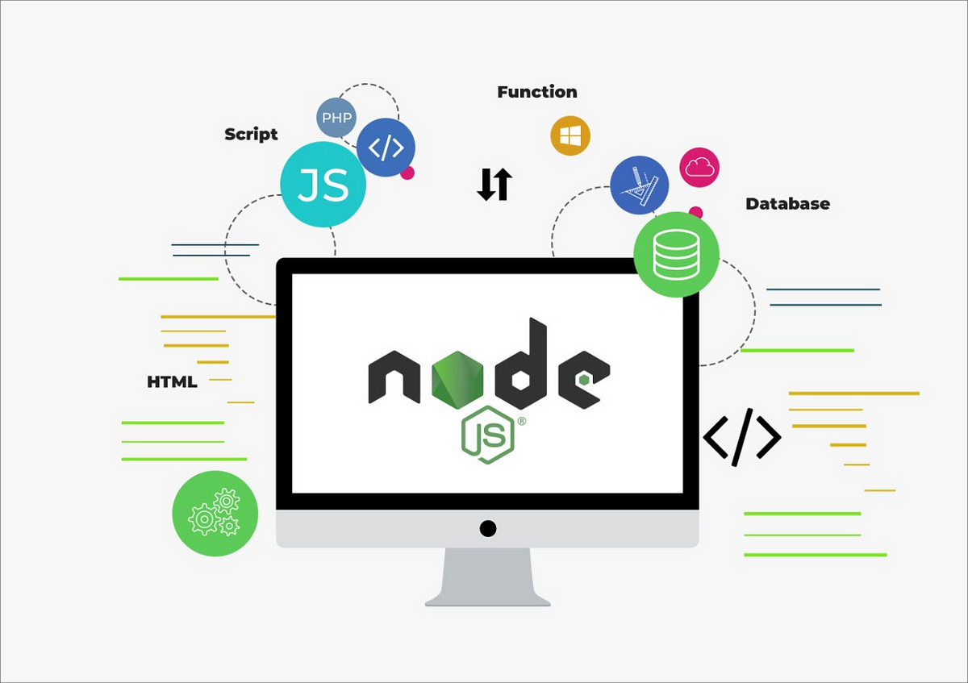
What is Node JS….!?
Node JS is an open-source and cross-platform runtime environment built on Chrome’s V8 JavaScript engine for executing JavaScript code outside of a browser. It provides an event-driven, non-blocking (asynchronous) I/O and cross-platform runtime environment for building highly scalable server-side applications using JavaScript.
Most people are confused and understand it’s a framework or a programing language. We often use NodeJS for building back-end services like APIs, Web App, or Mobile App. It’s utilized in production by large companies like Paypal, Uber, Netflix, Walmart, etc.

Slide 4
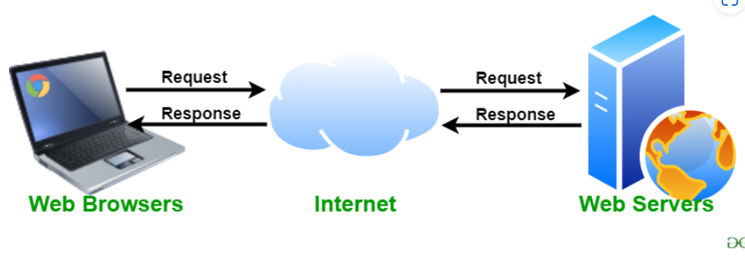
what is web server?
A web server is software and hardware that uses HTTP (Hypertext Transfer Protocol) and other protocols to respond to client requests made over the World Wide Web. The main job of a web server is to display website content through storing, processing and delivering webpages to users. Besides HTTP, web servers also support SMTP (Simple Mail Transfer Protocol) and FTP (File Transfer Protocol), used for email, file transfer and storage.
Examples of web server
sending and receiving emails;
downloading requests for File Transfer Protocol (FTP) files; and
building and publishing webpages.

Slide 5
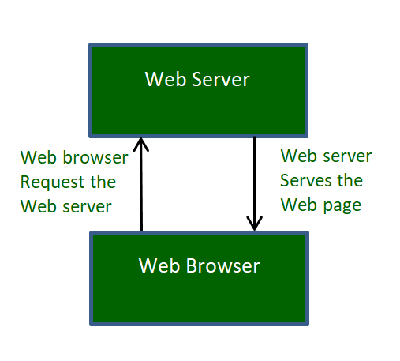
How do Web servers work?
A page on the internet can be viewed, when the browser requests it from the web server and the web server responds with that page. A simple diagrammatic representation of this is given below in the figure:

Slide 6
The simple process consists of 4 steps, they are:
Obtaining the IP Address from the domain name: Our web browser first obtains the IP address the domain name resolves to. It can obtain the IP address in 2 ways-
By searching in its cache.
By requesting one or more DNS (Domain Name System) Servers.
Browser requests the full URL: After knowing the IP Address, the browser now demands a full URL from the web server.
The web server responds to request: The web server responds to the browser by sending the desired pages, and in case, the pages do not exist or some other error occurs, it will send the appropriate error message.
The browser displays the web page: The Browser finally gets the webpages and displays it, or displays the error message.
Popular Web Servers: There are quite a few web servers available, like, Apache, Microsoft IIS, Nginx Web Server, and LightSpeed Web Server.
But, the two most popular ones are-
Apache HTTP Server
Microsoft Internet Information Service

Slide 7
Creating a web server using Node JS
There are mainly two ways as follows:
Using http inbuilt module
Using express third party module
Using http module:
HTTP and HTTPS, these two inbuilt modules are used to create a simple server. The HTTPS module provides the feature of the encryption of communication with the help of the secure layer feature of this module. Whereas the HTTP module doesn’t provide the encryption of the data.
Using express module:
The express.js is one of the most powerful frameworks of the node.js that works on the upper layer of the http module. The main advantage of using express.js server is filtering the incoming requests by clients.

Slide 8
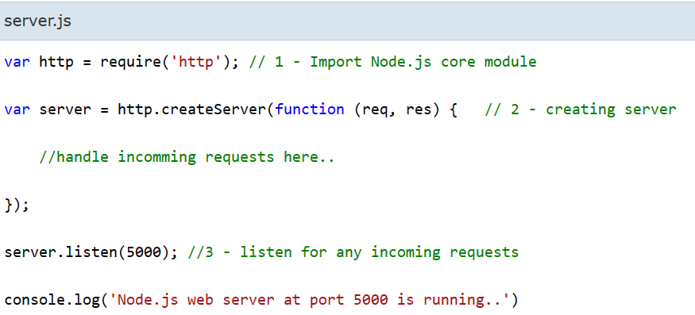
Create Node JS web server
Node.js makes it easy to create a simple web server that processes incoming requests asynchronously.
The following example is a simple Node.js web server contained in server.js file.
In the above example, we import the http module using require() function. The http module is a core module of Node.js, so no need to install it using NPM. The next step is to call createServer() method of http and specify callback function with request and response parameter.

Slide 9

Finally, call listen() method of server object which was returned from createServer() method with port number, to start listening to incoming requests on port 5000. You can specify any unused port here.
Run the above web server by writing node server.js command in command prompt or terminal window and it will display message as shown below
Output:
This is how you create a Node.js web server using simple steps. Now, let's see how to handle HTTP request and send response in Node.js web server.
Handle HTTP Request
The http.createServer() method includes request and response parameters which is supplied by Node.js. The request object can be used to get information about the current HTTP request e.g., url, request header, and data. The response object can be used to send a response for a current HTTP request.
The following example demonstrates handling HTTP request and response in Node.js.

Slide 10
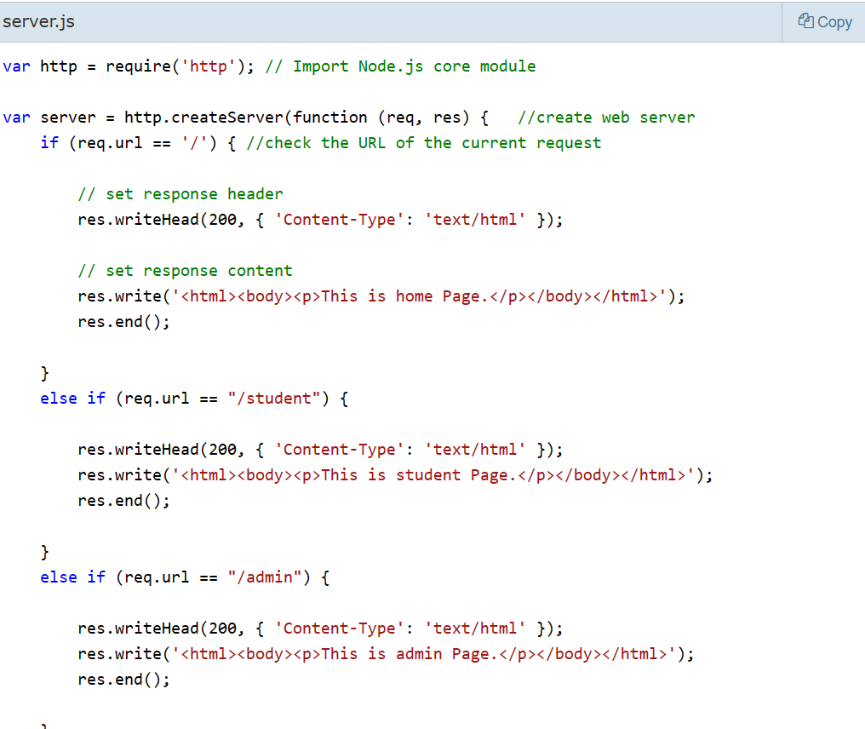
Add

Slide 11
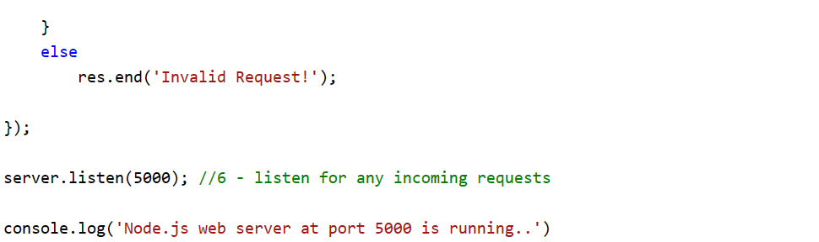


In the above example, req.url is used to check the url of the current request and based on that it sends the response. To send a response, first it sets the response header using writeHead() method and then writes a string as a response body using write() method. Finally, Node.js web server sends the response using end() method.
Now, run the above web server as shown below.
To test it, you can use the command-line program curl, which most Mac and Linux machines have pre-installed.

Slide 12
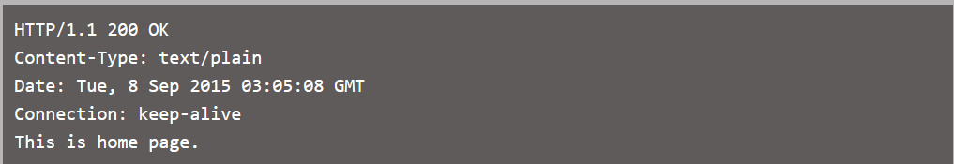
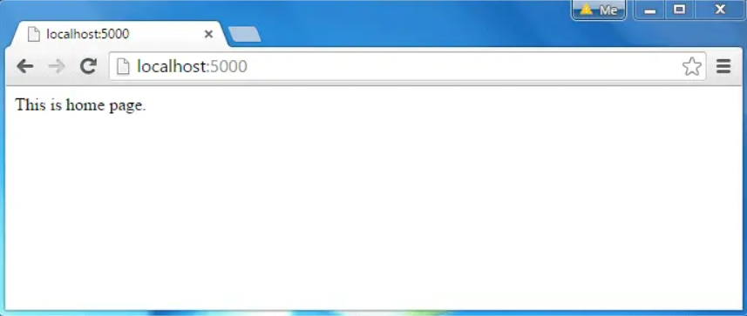
You should see the following response.
For Windows users, point your browser to http://localhost:5000 and see the following result.

Slide 13
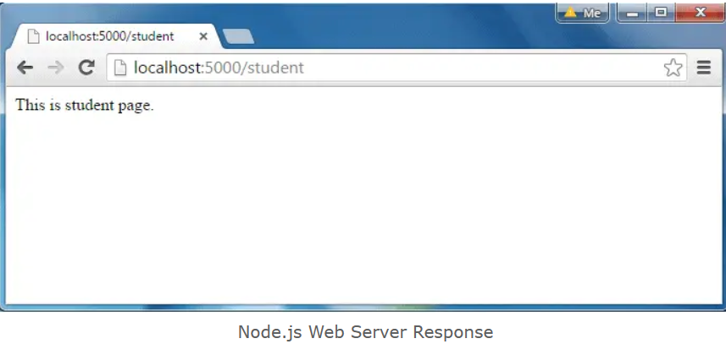
The same way, point your browser to http://localhost:5000/student and see the following result.

Slide 14
Conclusion:
The journey through creating a web server using Node.js delves into the heart of modern, scalable web development. Node.js, with its non-blocking, event-driven architecture, empowers developers to build high-performance applications, handling concurrent connections efficiently.
In conclusion, creating a web server with Node.js is not just a technical endeavor; it's an exploration of a technology that has transformed the landscape of server-side development. As you embark on your Node.js journey, remember that it is a tool that empowers innovation and creativity, allowing you to build robust, scalable, and high-performance applications.

Slide 15


